Slide 1
4 High-Level Database Models
In a design phase, we address and answer questions about what information will be stored, how information elements will be related to one another, what constraints such as keys or referential integrity may be assumed, and so on.
The notation in which the design is expressed: entity-relationship diagram(实体-联系图), UML(统一建模语言), ODL(对象描述语言).
High-Level
design
Relationalschema
Relational database
Ideas

Slide 2
4.1 The Entity/Relationship Model
Design is a serious business.
The “boss” knows they want a database, but they don’t know what they want in it.
Sketching(作图) the key components is an efficient way to develop a working database.

Slide 3
4.1 The Entity/Relationship Model
The E/R model(实体/联系模型) allows us to sketch database designs.
Kinds of data and how they connect.
Not how data changes.
Designs are pictures called entity-relationship diagrams(实体/联系图).

Slide 4
4.1.1 Entity Sets
Entity(实体): An abstract object, similar to an object in OOL.
Entity sets: A collection of similar entities, similar to a class of objects.
Entity sets include some entity, such as Movies & Movie.

Slide 5
4.1.2 Attributes
Attributes(属性): properties of the entities in an entity set. Attributes are simple values, e.g. integers or character strings.
A movie entity has the following attributes, such as title, year, length, genre, and so on.

Slide 6
4.1.3 Relationship
Relationships(联系): connections among two or more entity sets.
Movies
Stars-In
Stars

Slide 7
4.1.4 Entity-Relationship Diagrams
In an entity-relationship diagram:
Each movie is an entity, and the set of all movies constitutes an entity set.
A relationship is represented by a diamond, with lines to each of the entity sets involved.
title
year
name
address
Movies
Stars-In
Stars
length
genre

Slide 8
4.1.5 Instances of an E/R Diagram
For the relationship stars-in, we might have a relationship set like:
The tuples of a relationship set are not really tuples of a relation, since their components are entities.
Movies | Stars
Basic Instinct | Sharon Stone
Total Recall | Arnold Schwarzenegger
Total Recall | Sharon Stone

Slide 9
4.1.6 Multiplicity of Binary E/R Relationships
Multiplicity of the relationship from entity set E to entity set F:
If each member of E can be connected by R to at most one member of F, then we say that R is many-one from E to F.
If R is both many-one from E to F and many-one from F to E, then we say that R is one-one.
If R is neither many-one from E to F or from F to E, then we say R is many-many.

Slide 10

4.1.6 Multiplicity of Binary E/R Relationships
Representing “Multiplicity”:
Show a many-one relationship by an arrow entering the “one” side.
Show a one-one relationship by arrows entering both entity sets.

Slide 11
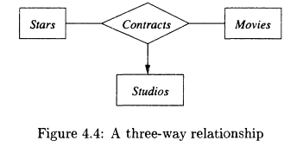
4.1.7 Multiway Relationships
Sometimes, we need a relationship that connects more than two entity sets.
A ternary (three-way) relationship is rare.
Contracts is a ternary relationship.
The relationship can be described by a 3-tuples of the form: (studio, star, movie)

Slide 12
4.1.8 Roles（角色） in Relationships
Sometimes an entity set appears more than once in a relationship.
Label the edges between the relationship and the entity set with names called roles.
Original
Consider the manage relationship (superior-inferior) between the entity set “employees” and itself.
Sequel-of
Movies
Sequel

Slide 13
4.1.8 Roles in Relationships
Example 4.7: A four-way relationship
Movies
Contracts
Stars
Studio of star
Producing Studio
Studios

Slide 14
4.1.9 Attributes on Relationships
Sometimes it is useful to attach an attribute to a relationship.
Think of this attribute as a property of tuples in the relationship set.
We may associate the attributes “salary” and “signdate” with the ternary relationship “contracts”.

Slide 15
4.1.9 Attributes on Relationships
Signdate
Salary
Contracts
Stars
Movies
Studios

Slide 16
4.1.10 Converting Multiway Relationships to Binary
How to convert multiway relationships to binary without losing any information?
Take a ternary relationship for example:
Convert the ternary relationship to a new entity set called a connecting entity set(连接实体集).
Confirm the attributes of the connecting entity set.
Build three binary, many-one relationship from the connecting entity set to each of the three old entity sets.

Slide 17
4.1.10 Converting Multiway Relationships to Binary
Signdate
Salary
Movies
Movies
Contracts
Stars
Stars
Movie-of
Contracts
Star-of
Studios
Studio-of
Studios

Slide 18
4.1.10 Converting Multiway Relationships to Binary
What is a connecting entity set?
It’s a kind of special entity sets, and it can represent a relationship.
It generally has attributes.
Which relationships should be converted to entity sets?
Multiway relationships
Many-many relationships
The relationships associated with attributes

Slide 19
4.1 The Entity/Relationship Model
Exercises:
P138 4.1.1 4.1.2

Slide 20
4.2 Design Principles
Design principles:
The principles guiding us to analyze requirement and design system.
Why do we need design principles?
In order to reflect requirement truly and completely, constitute a good design, and avoid usual problems.
Faithfulness(忠实性)
Avoiding redundancy
Simplicity counts
Choosing the Right Relationships
Picking the Right Kind of Element

Slide 21
4.3 Constraints(约束) in the E/R Model
Keys in E/R Diagrams:
Underline the key attribute(s).
title
year
Movies
length
genre

Slide 22
4.3 Constraints(约束) in the E/R Model
Reference(参照, 引用):
A way of relating objects;
A reference requires the referenced object must exist.
If a referenced object is deleted while the reference remain, “dangling(悬挂)” is appeared.
Referential integrity:
A kind of single-value constraints: the entity “referenced” by the relationship must exists in our database.
Example: the relationship Owns between Movies and Studios

Slide 23
4.3 Constraints(约束) in the E/R Model
How to express referential integrity in E/R diagrams?
rounded arrow
Movies
Owns
Studios

Slide 24
4.4 Weak Entity Sets
Entity sets fall into a hierarchy(层次).
Example:
Studios and Crews;
crewChief
number
name
address
name
Crews
Unit-of
Studios

Slide 25
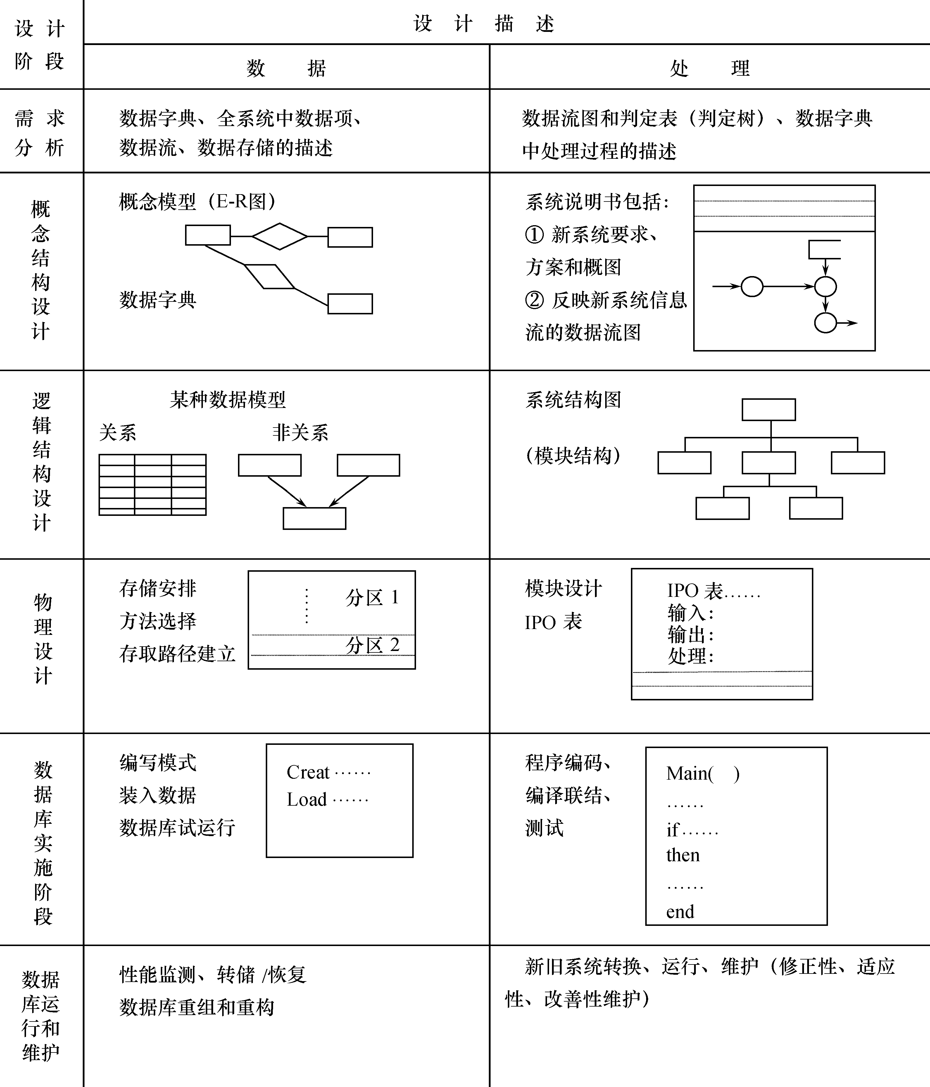

Slide 26
4.5 From E/R Diagrams to Relational Designs
Main idea:
Conversion from entity sets to relations
Conversion from relationships to relations
Handling weak entity sets and subclasses

Slide 27
4.5.1 From Entity Sets to Relations
Entity sets -> relations.
Attributes -> attributes.
title
year
name
address
Stars-in
Movies
Stars
length
genre
Owns
Studios
Movies (title, year, length, genre)
Stars (name, address)
Studios (name, address)
name
address

Slide 28
4.5.2 From E/R Relationships to Relations
How to convert multiway relationships to relations?
Convert multiway(多元) relationships to binary(二元) relationships firstly.
How to convert binary relationships to relations?
It’s up to multiplicity of the relationship.

Slide 29
4.5.2 From E/R Relationships to Relations
A many-many relationship R from E1 to E2
Convert R to a relation whose attributes are composed of the attributes of R and the key attributes of E1 and E2.

Slide 30
4.5.2 From E/R Relationships to Relations
title
year
name
address
Stars-in
Movies
Stars
length
genre
Owns
Studios
name
address
Movies (title, year, length, genre)
Stars (name, address)
Studios (name, address)
Stars-in (title, year, starName)

Slide 31
4.5.2 From E/R Relationships to Relations
2. A many-one relationship R from E1 to E2
R can be converted to a relation(but not must be).
Add the key attributes of E2 to the relation E1.

Slide 32
4.5.2 From E/R Relationships to Relations
title
year
name
address
Stars-in
Movies
Stars
length
genre
Owns
Studios
name
address
Movies (title, year, length, genre)
Stars (name, address)
Studios (name, address)
Movies (title, year, length, genre, studiosName)
Stars-in (title, year, starName)

Slide 33
4.5.2 From E/R Relationships to Relations
3. A one-one relationship R from E1 to E2
R can be converted to a relation, but usually not.
There are two ways:
Add the key attributes of E2 to the relation E1.
Add the key attributes of E1 to the relation E2.
An one-one relationships may be merged into another.

Slide 34
4.5.2 From E/R Relationships to Relations
If one entity set is involved several times in a relationship, in different roles, or the same attribute name appear twice or more in a relation, then we need to rename to avoid duplication.
Original
Sequel-of
Movies
Sequel
Movies (title, year, length, genre)
Movies (title, year, length, genre, title, year)
Movies (title, year, length, genre, originalTitle, originalYear)

Slide 35
4.5.4 Handling Weak Entity Sets
Conversion from weak entity sets to relations ：
Convert weak entity set E to a relation whose attributes are composed of the attributes of E and the key attributes of F.
Can not convert R to a relation.
E
R
F

Slide 36
4.5.4 Handling Weak Entity Sets
crewChief
number
name
address
Crews
Unit-of
Studios
Studios (name, address)
Crews (studioName, number, crewChief)

Slide 37
4.5.4 Handling Weak Entity Sets
year
signdate
salary
name
title
Movies
Movie-of
Contracts
Star-of
Stars
Studio-of
addr
Studios
name
addr
Contracts (starName, studioName, title, year, salary, signdate)
Contracts (NO, starName, studioName, title, year, salary, signdate)

Slide 38
4.5 From E/R Diagrams to Relational Designs
Exercises:
P163 4.5.1 4.5.2

